Slide 1
Multi-sensor rail track detection in automatic train operations
Master’s thesis in Data Science
Student: Attila Kovacs
1st Advisor: Lukas Rohatsch (FH Technikum)
2nd Advisor: Daniele Capriotti (M2C Expert Control GmbH)
Alignment: 17.11.2023

Slide 2
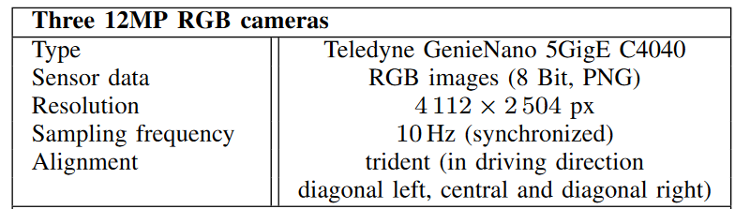
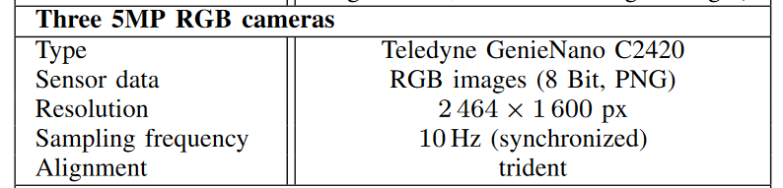
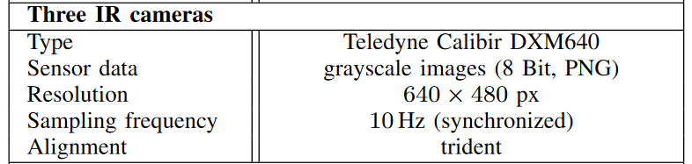
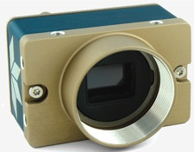
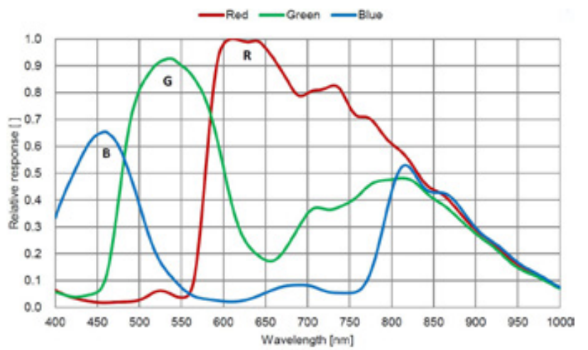
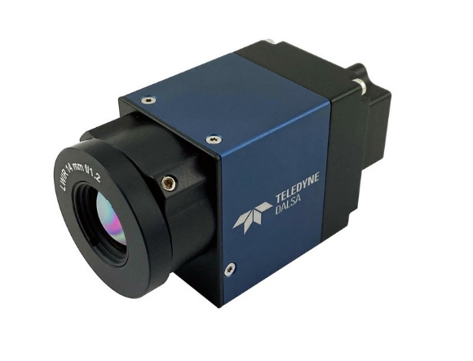
Sensors
RGB 12 MP
Pixel size: 3.45 µm
FPS: 40
RGB 5 MP
Pixel size: 3.45 µm
FPS: 35
Infrared 0,3 MP
Pixel size: 17 µm
FPS: 30
Wavelength: 8 µm – 14 µm

Slide 3
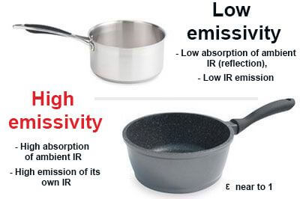
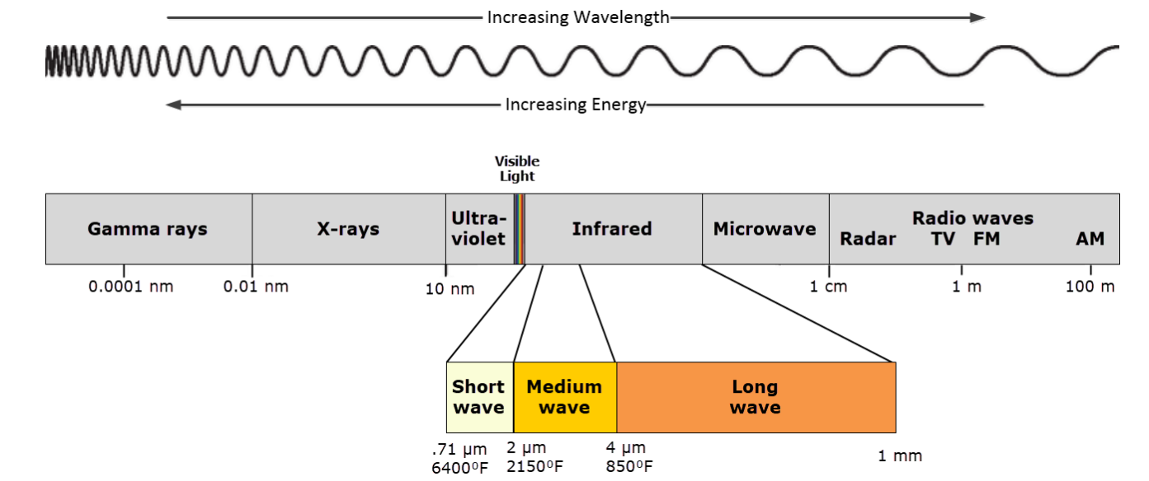
Sensors
Microbolometers used in IR
Hot objects emit at short wavelengths
Cold objects emit at long wavelengths
Emissivity is a measure of how well an object radiates heat
Polished metallic surfaces have low emissivity ~ 0.14 – 0.38
Organic material have a emissivity rate of ~ 0.95
No exposure time to fill a pixel with photons
The microbolometer sensor is constantly exposed

Slide 4
Modelling rail detection as segmentation
Semantic segmentation → deep learning algorithm that associates a label or category with every pixel in an image
Distinguish background pixels and track pixels
In the data tracks are annotated by lines rather than pixel masks

Slide 5
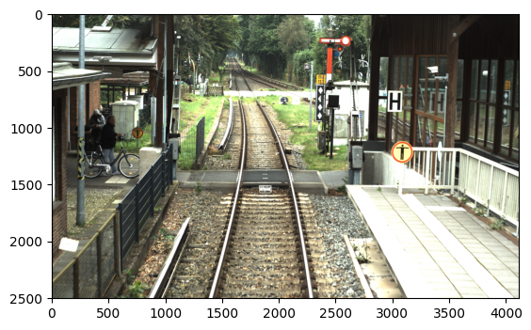
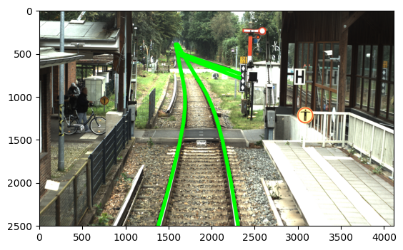
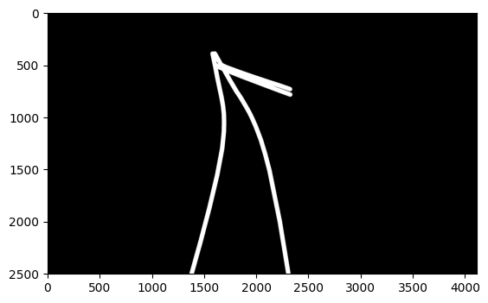
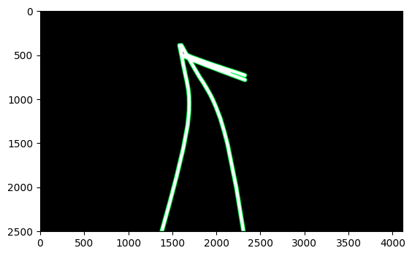
Modelling rail detection as segmentation
Original image
Thick polylines
Mask
Mask with contour

Slide 6
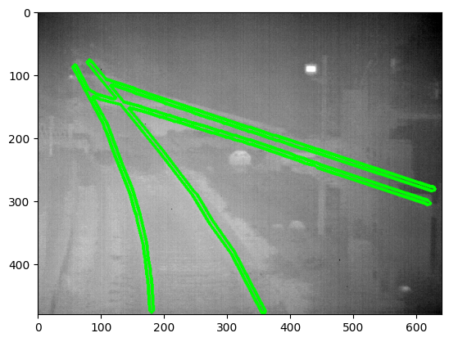
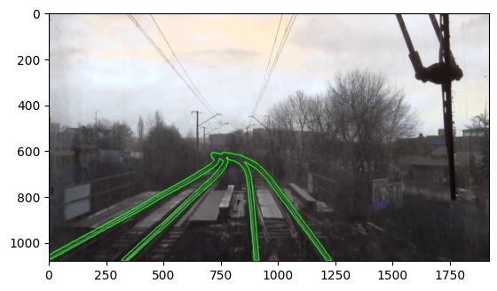
Modelling rail detection as segmentation
Example IR
Example RailSem

Slide 7
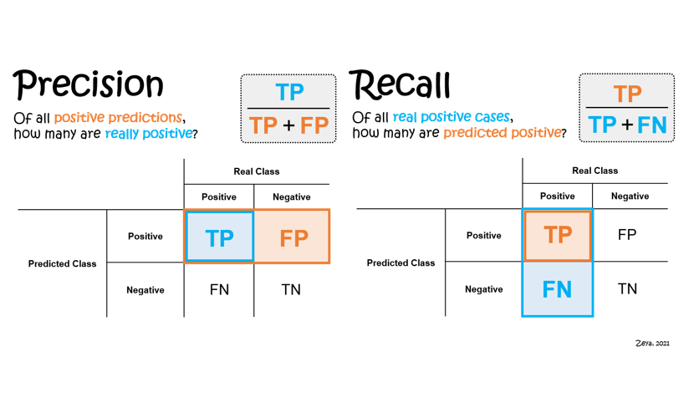
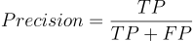
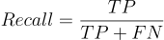
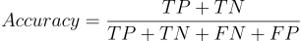
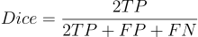
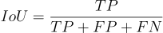
Performance metrics

Slide 8
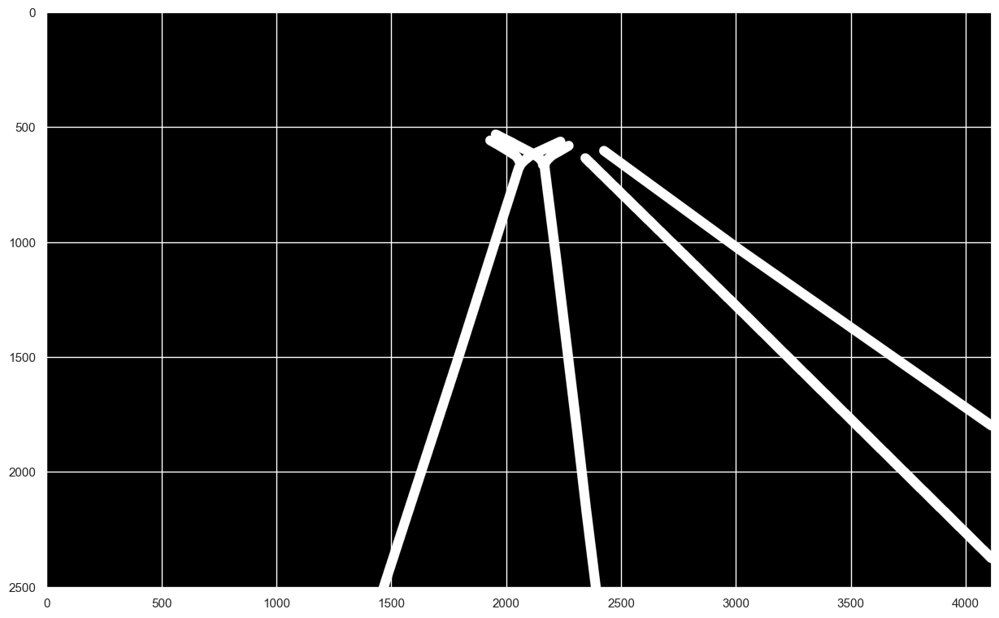
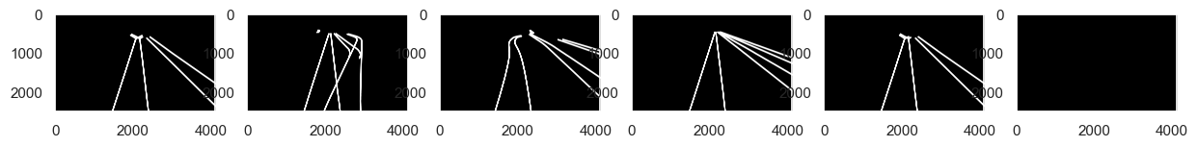
Performance metrics
pixel_acc: 0.9983
dice: 0.9775
precision: 0.9812
recall: 0.9738
iou: 0.9559
pixel_acc: 0.9499
dice: 0.3762
precision: 0.3557
recall: 0.3992
iou: 0.2317
pixel_acc: 0.9205
dice: 0.0567
precision: 0.0514
recall: 0.0633
iou: 0.0292
pixel_acc: 0.9435
dice: 0.3703
precision: 0.3201
recall: 0.4392
iou: 0.2272
pixel_acc: 0.9979
dice: 0.9714
precision: 0.9787
recall: 0.9643
iou: 0.9444
pixel_acc: 0.9622
dice: 0.0000
precision: 1.0000
recall: 0.0000
iou: 0.0000

Slide 9
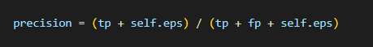
Performance metrics
pixel_acc: 0.9983
dice: 0.9775
precision: 0.9812
recall: 0.9738
iou: 0.9559
pixel_acc: 0.9499
dice: 0.3762
precision: 0.3557
recall: 0.3992
iou: 0.2317
pixel_acc: 0.9205
dice: 0.0567
precision: 0.0514
recall: 0.0633
iou: 0.0292
pixel_acc: 0.9435
dice: 0.3703
precision: 0.3201
recall: 0.4392
iou: 0.2272
pixel_acc: 0.9979
dice: 0.9714
precision: 0.9787
recall: 0.9643
iou: 0.9444
pixel_acc: 0.9622
dice: 0.0000
precision: 1.0000
recall: 0.0000
iou: 0.0000

Slide 10
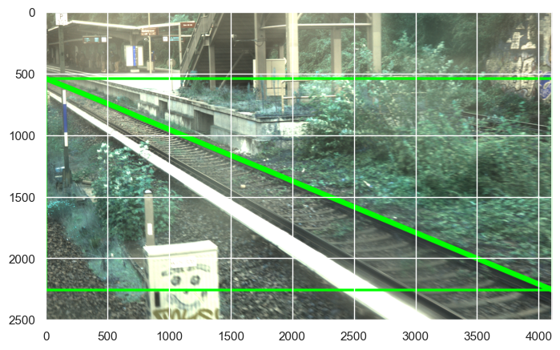
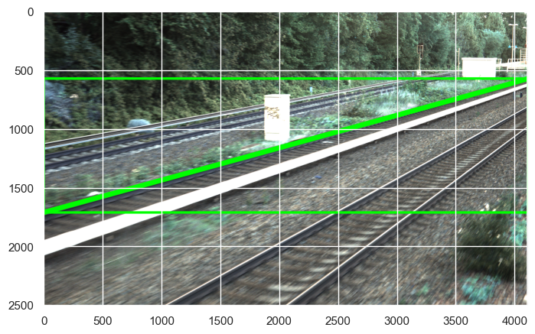
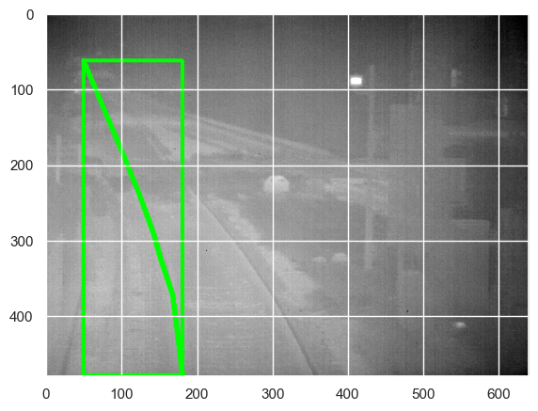
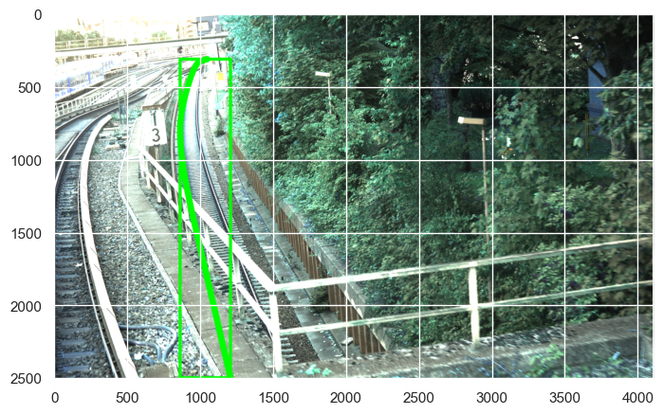
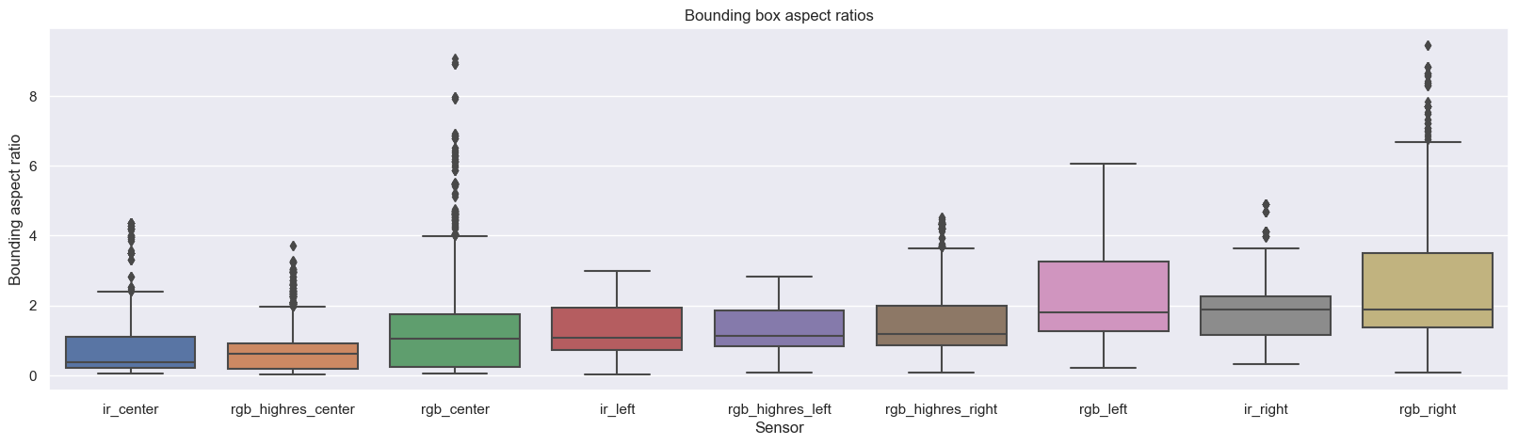
Baselining with FLD Analyzing Bounding Boxes

Slide 11
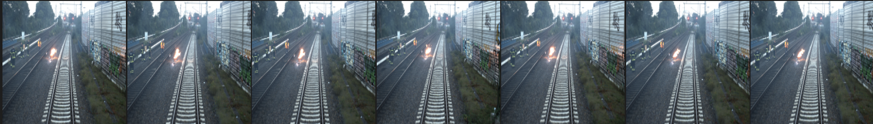
Baselining with FLD Select samples
For tuning the FLD parameters we select only a subset of the training data
Given the simirality between frames of the same video we cannot expect significant differences
Additionally, the number of frames in the video might bias the analysis

Slide 12
Baselining with FLD Parameter tuning
sensor=("rgb_highres_left" "rgb_highres_right" "rgb_highres_center" "rgb_left" "rgb_right" "rgb_center" "ir_left" "ir_right" "ir_center")
kernel=("0" "5" "15" "25" )
length_treshold=("25" "50" "100" "200" "300" "400")
aspect_ration_quantile=("1" "5" "10")
canny_th1=("5" "10" "15" "20" "50" "100" "150" "200")
canny_th2 = canny_th1 * 3
NOT ALL COMBINATIONS HAVE BEEN TESTED In total, 3348 experiments have been conducted

Slide 13
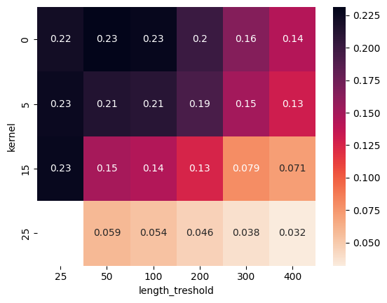
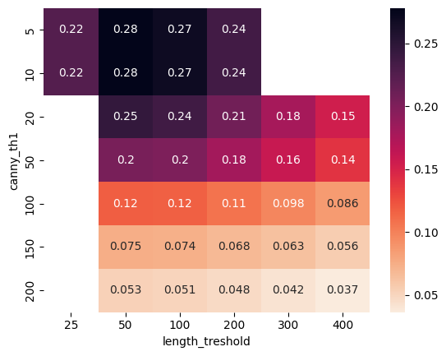
Baselining with FLD Parameter tuning based on dice metric
Each setting is averaged over all sample images
Interestingly, low length tresholds provide better results

Slide 14
Baselining with FLD Best parameters for each sensor
sensor | kernel | Length treshold | aspect_ration quantile | canny_th1 | canny_th2 | dice
rgb_highres_center | 5 | 200 | 1 | 50 | 150 | 0.458045
rgb_highres_right | 5 | 100 | 5 | 50 | 150 | 0.397419
rgb_right | 5 | 100 | 1 | 10 | 30 | 0.372880
rgb_center | 5 | 100 | 1 | 20 | 60 | 0.349459
rgb_highres_left | 5 | 100 | 10 | 50 | 150 | 0.339987
ir_left | 5 | 50 | 1 | 5 | 15 | 0.321330
rgb_left | 5 | 100 | 1 | 10 | 30 | 0.273037
ir_center | 5 | 25 | 5 | 5 | 15 | 0.257382
ir_right | 5 | 25 | 5 | 10 | 30 | 0.190959

Slide 15
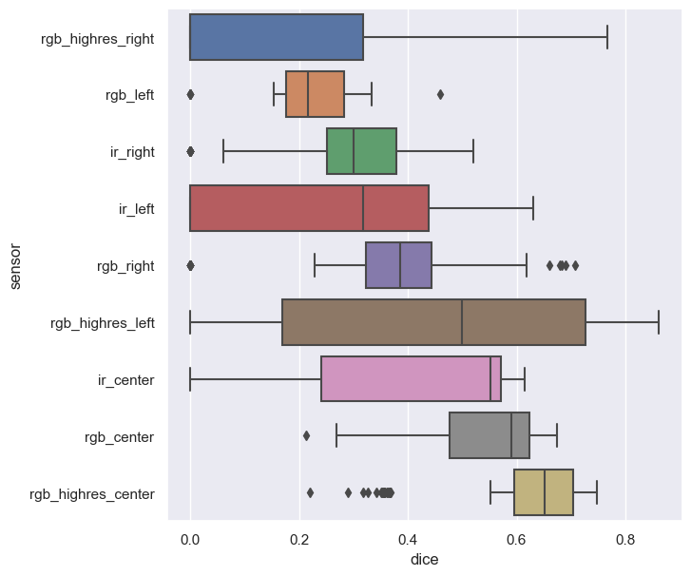
Baselining with FLD Performance on validation data

Slide 16
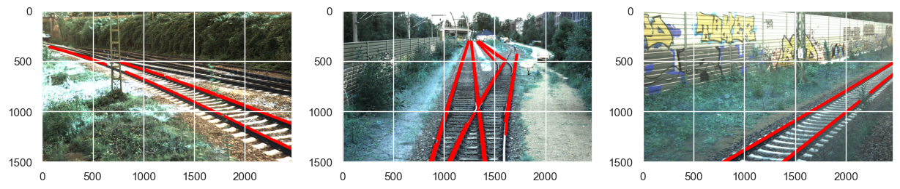
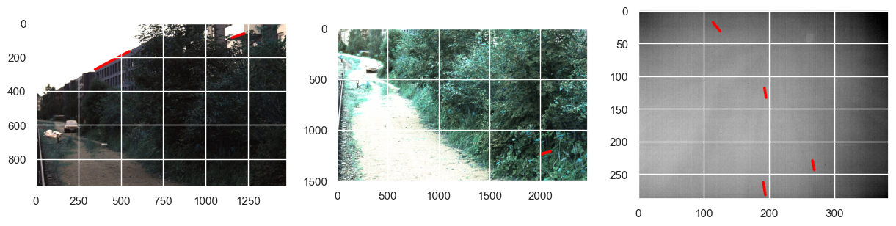
Baselining with FLD Good examples and bad examples

Slide 17
Deep learning approach
YOLOv8 as framework
Can be used for segmentation and object detection
State-of-the-art computer vision model built by Ultralytics
Easy to use
Open source

Slide 18
Deep learning approach
YOLOv8 as framework
Can be used for segmentation and object detection
State-of-the-art computer vision model built by Ultralytics
Easy to use
Open source
Experiments performed on FHTW HPC

Slide 19
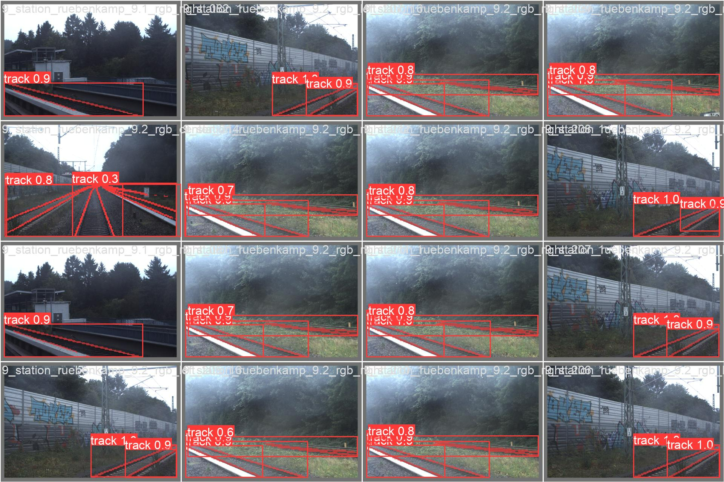
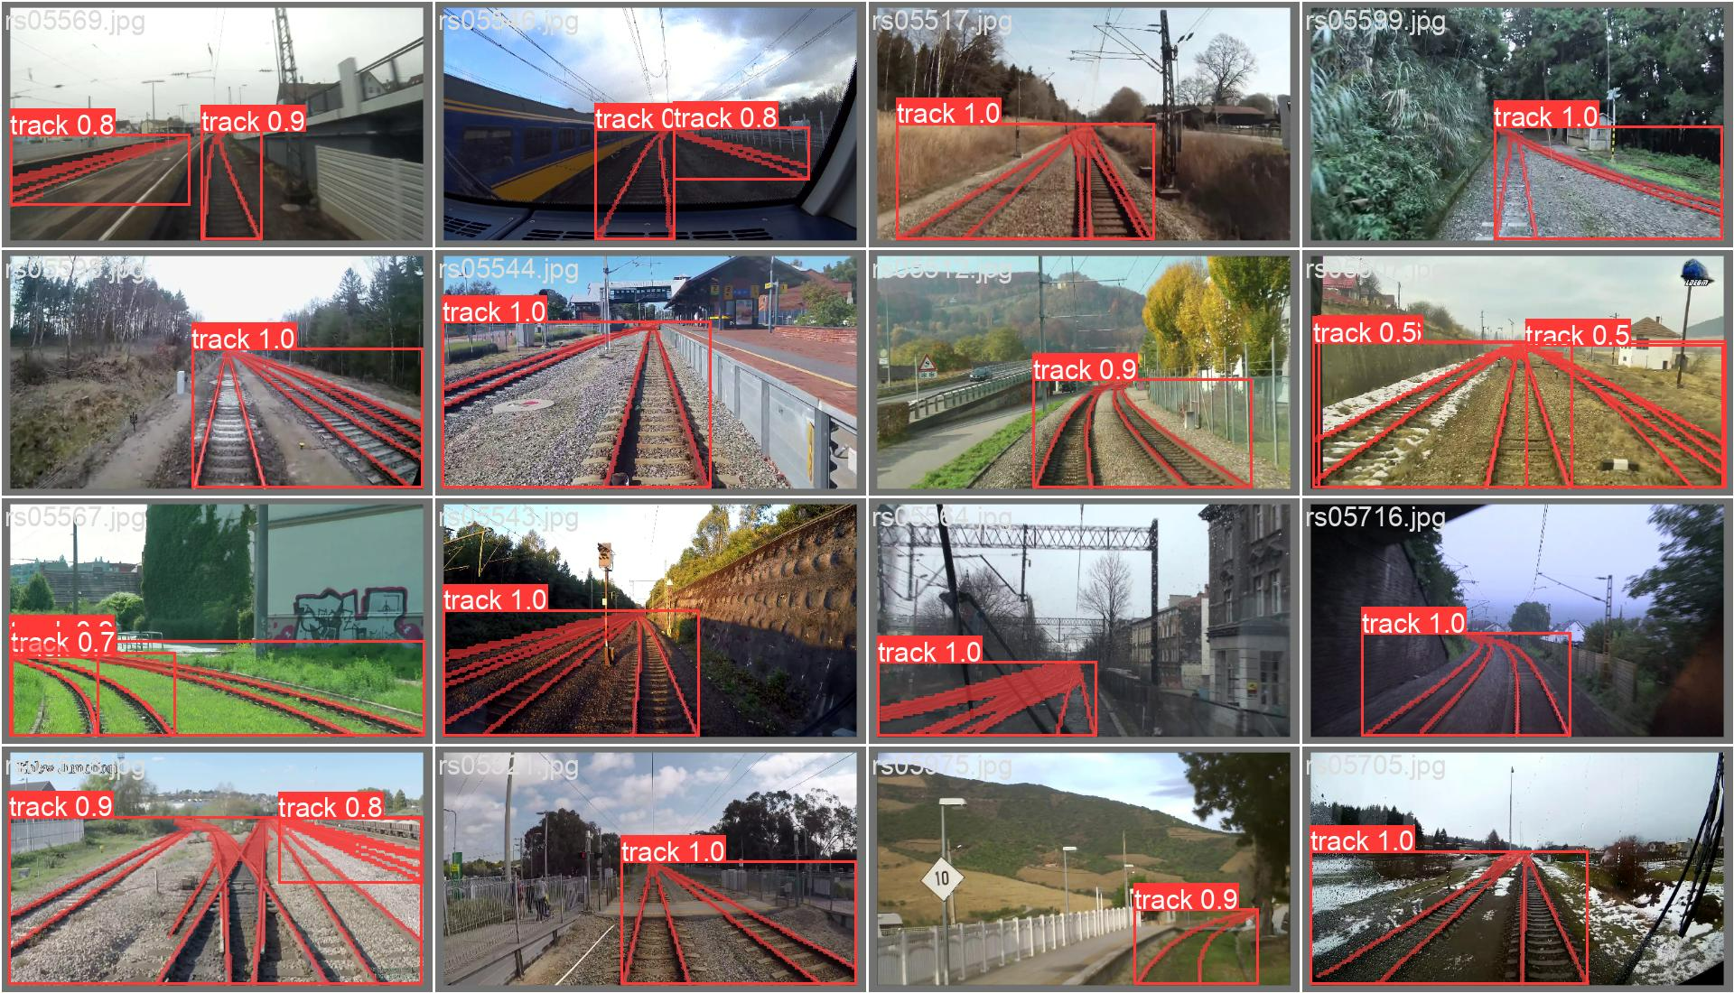
YOLOv8 First experiments - RGB
Without RailSem data
With RailSem data

Slide 20
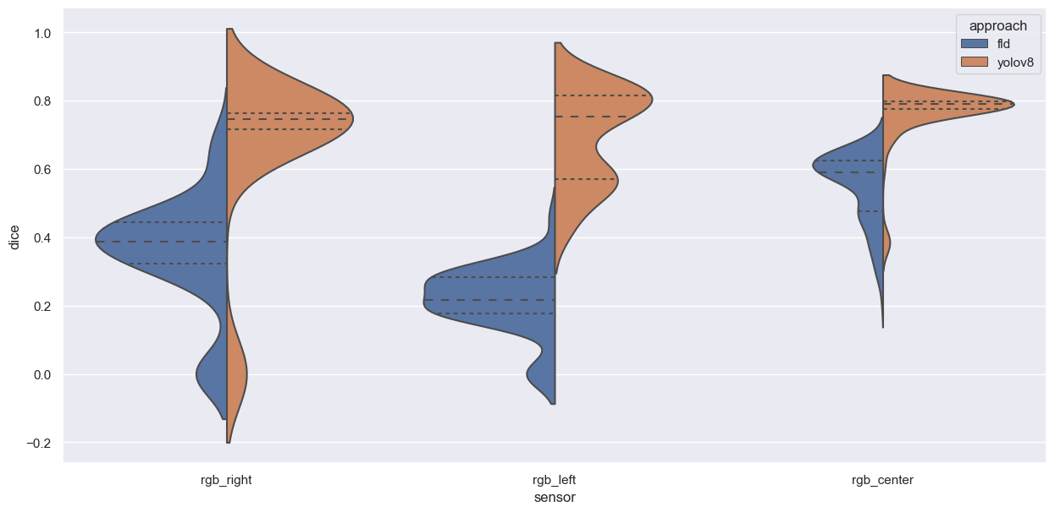
YOLOv8 vs FDL Performance on validation data

Slide 21
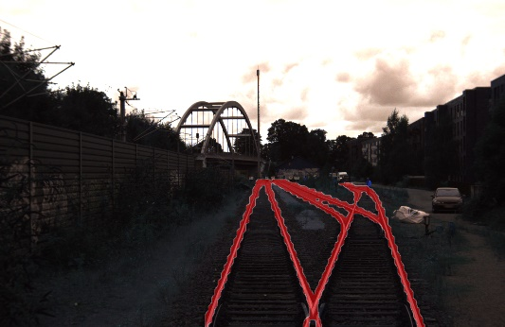
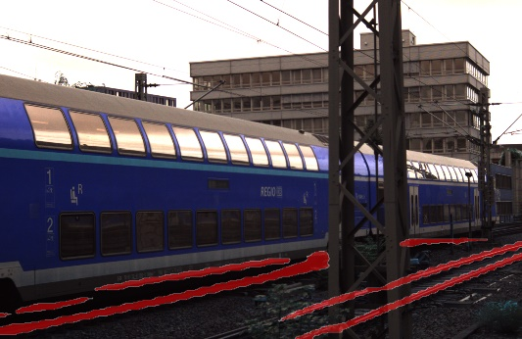
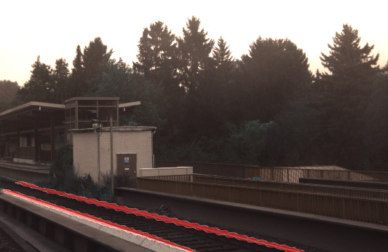
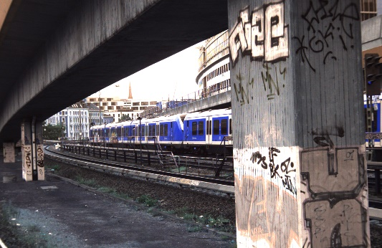
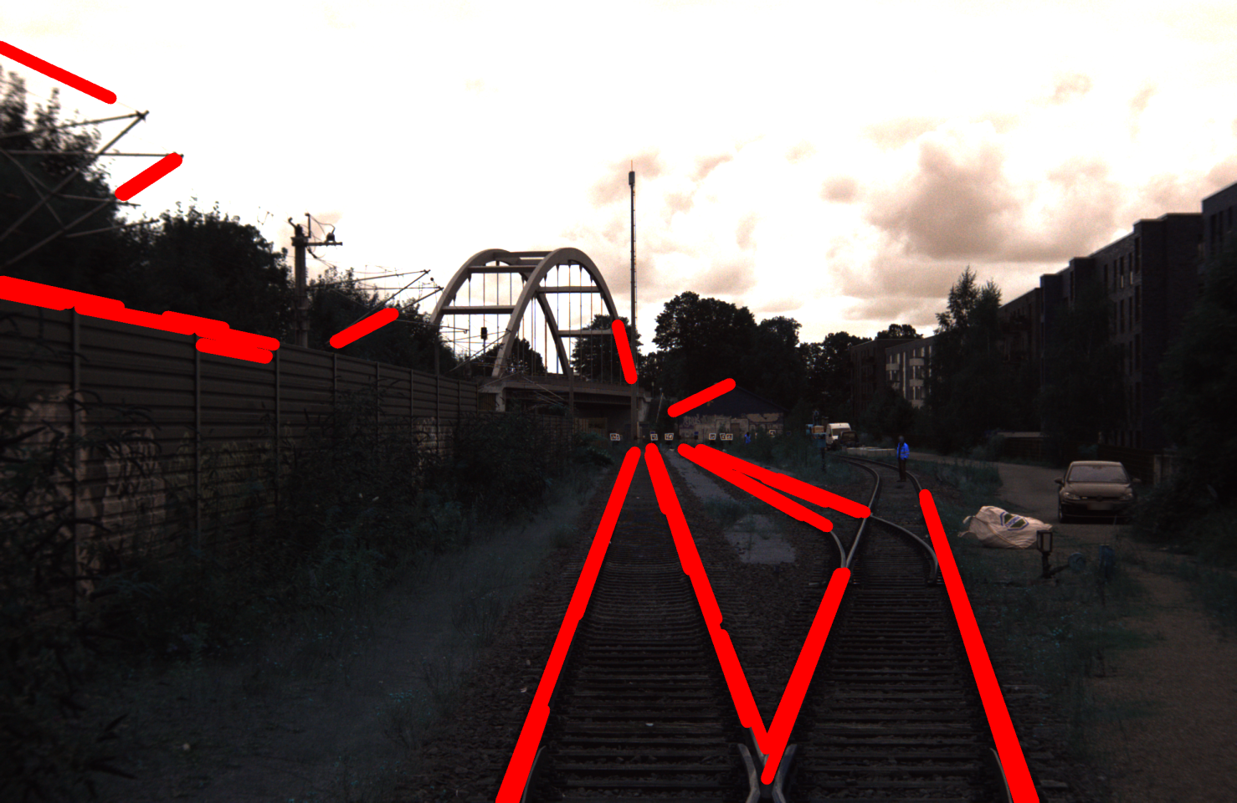
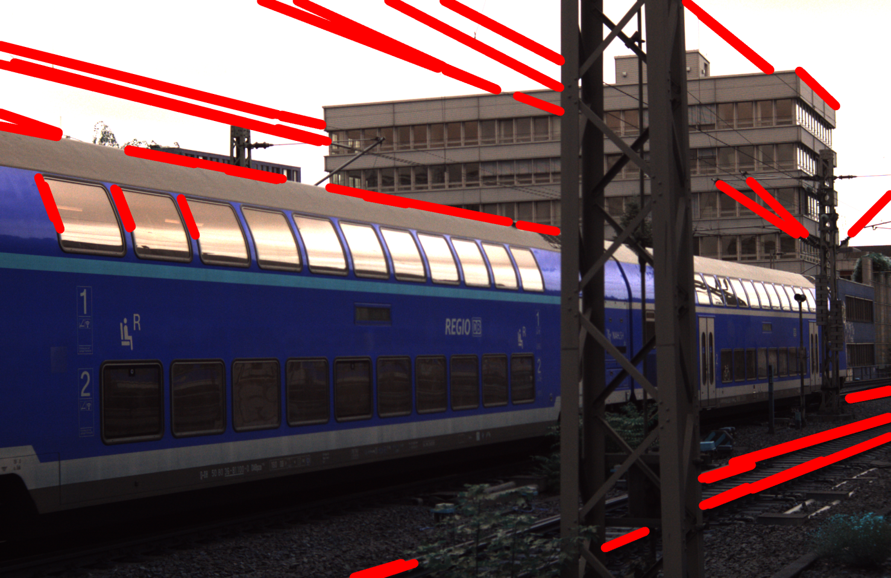
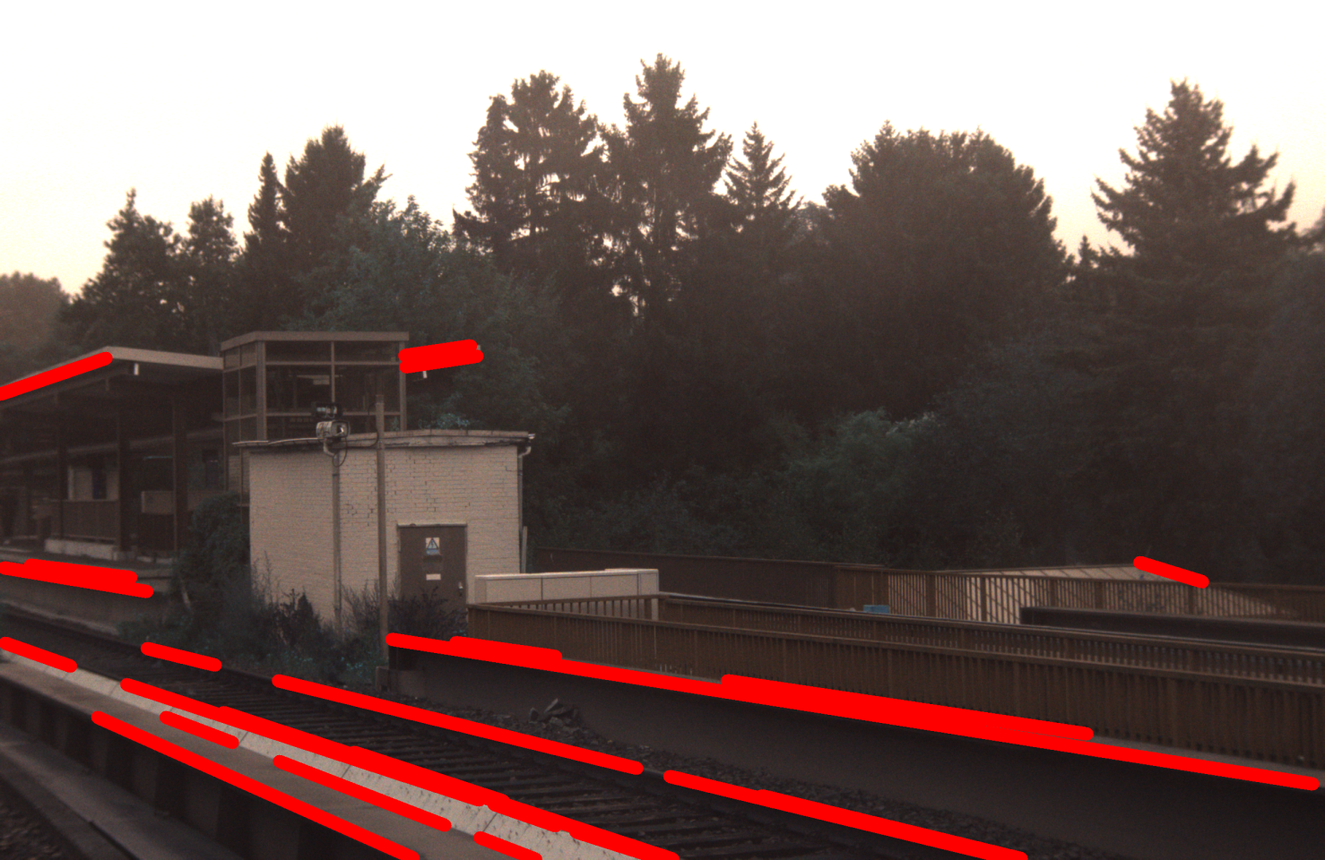
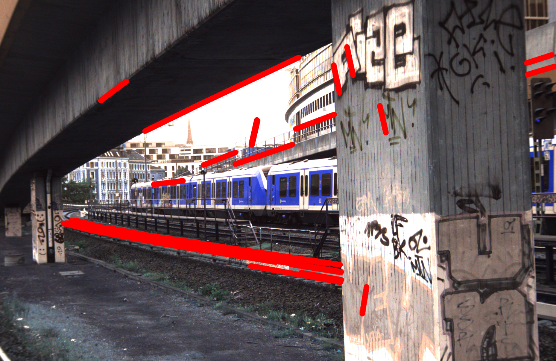
YOLOv8 Examples
YOLOv8
Baseline

Slide 22
Next steps
Experiment with different model settings (one model for all sensors, one model per sensor)
Select final model setting
Perform analysis on results

Slide 23
Research questions
Which modelling technique and which deep learning model can be applied to solve the rail detection problem?
How can the efficiency of standard, high-resolution, and infrared cameras be compared against each other; does a higher resolution result in a higher accuracy?
What is the trade-off between model accuracy and speed of providing predictions when applied to a video stream in real time?
How do deep learning models perform compared to gradient-based thresholding approaches in terms of, e.g., accuracy (share of correctly identified objects) or F1-score (mean of precision and recall)

Slide 24
Fragen
Ist die aktuelle Richtung in Ordnung?
Fragestellung: Wo liegen Schienen genau (Hauptschiene, Nebenschienen)
Anreichern der Daten mit alternativ Sets
FastLineDetection als Baseline
Finetuning
Parametertuning
Result selection
Modellierung als „Segmentation Model“
Lösungsansatz YOLOv8
Nächste Abstimmung: 17.11.2023 13:00

